Slide 1

Card Builder
Pokémon: Legends of Sinnoh
Welcome to this small utility/guide for adding custom Pokémon to Legends of Sinnoh.
The custom Pokémon are considered as “Distortion World Anomalies” which gives them a chance to show up in all encounter searches.
You have complete freedom over all attributes of the custom Pokémon. Feel free to use moves already in the game or implement new ones however you wish!
Only Pokémon models up to Generation 4 have been loaded into the game. I will try to add the rest if there is demand for them.

Slide 2

























Assets
Pokémon type images to be resized according to the templates:
Pokémon art images can be found on Serebii or elsewhere.
Encounter tier icons:
Final evolution icon:

Slide 3




?
Distortion World Anomaly
?
?
?
Move Name
?
Move effect.

Slide 4
?
Distortion World Anomaly
?
?
?
Move Name
?
Move effect.

Slide 5
Move Name
?
Move effect.

Slide 6
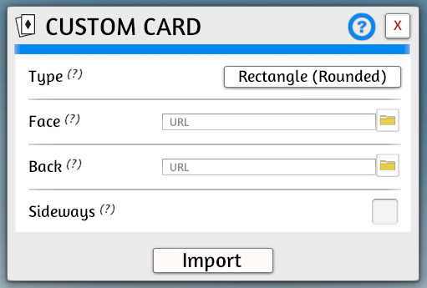
Adding to TTS
In PowerPoint, save your face and back images locally by drag selecting everything, right clicking and “Save as Picture…”.
In TTS, go to Objects > Components > Cards > Custom Card.
Keep “Type” as “Rectangle (Rounded)”, add your face and back images. Make sure to have them uploaded to your Steam Cloud when given the option.
After pressing “Import”, you will now have your new card. Rescale it using the Gizmo tool: X=1.50, Y=1.00, Z=1.50.

Slide 7
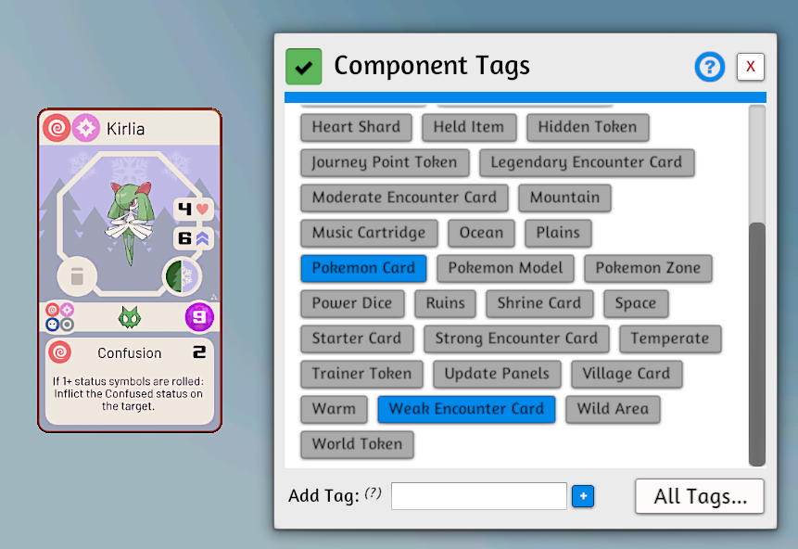
Adding Tags
Right click your Pokémon card and go to Tags.
All Pokémon cards need this tag:
Pokemon Card
Add a tag based on the Encounter Tier:
Starter Card
Weak Encounter Card
Moderate Encounter Card
Strong Encounter Card
Legendary Encounter Card

Slide 8
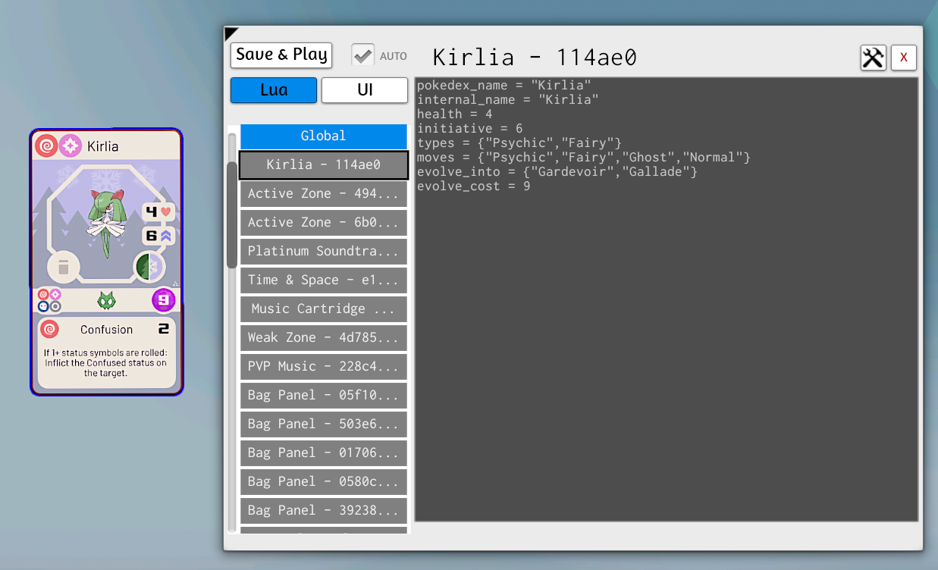
Adding Data
Make sure you have saved your work so far
Right click your Pokémon card and go to Scripting > Scripting Editor.
pokedex_name = "Kirlia"
internal_name = "Kirlia"
health = 4
initiative = 6
types = {"Psychic", "Fairy"}
moves = {"Psychic", "Fairy", "Ghost", "Normal"}
evolve_into = {"Gardevoir", "Gallade"}
evolve_cost = 9
The “pokedex_name” and “internal_name” should be set to the same value. The “moves” are the Learnable Move Types of the Pokémon. If a Pokémon has no evolutions, set ”evolve_into” and “evolve_cost” equal to nil.
Fill out the template above, add it to the card using the Scripting Editor and then press “Save & Play”.

Slide 9
Final Points
You can now add a name and description to the card.
If your Pokémon has evolutions, you will want to add some clones of the evolutions to the Evolution Pokémon deck.
For example, with official cards:
Shinx has 1 card in the Weak Pokémon deck.
Luxio has 1 card in the Weak Pokémon deck and 1 clone in the Evolution Pokémon deck.
Luxray has 1 card in the Strong Pokémon deck and 2 clones in the Evolution Pokémon deck.
Evolution Pokémon cards need this tag:
Evolution Card
Hopefully, that should be everything, have fun with your custom Pokémon!

